Slide 1

Autism Spectrum Disorder in Alabama
March 5, 2018

Slide 2

https://www.youtube.com/watch?v=1UMqowz_Z_Q&feature=youtu.be

Slide 3
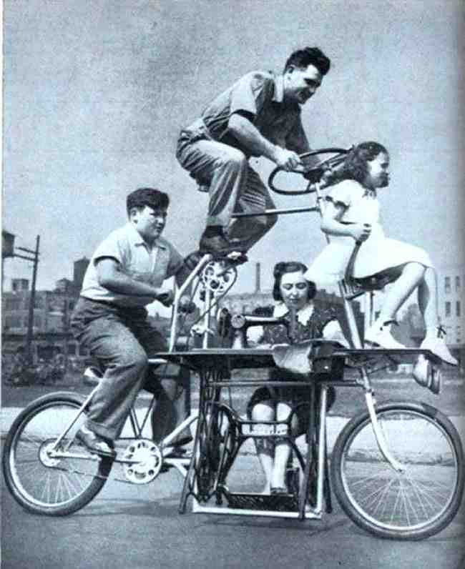
“Invention, my dear friends, is 93% perspiration, 6% electricity, 4% evaporation, and 2% butterscotch ripple”

Slide 4
Did you know…
Autism affects 1 in 59
Autism prevalence figures are growing
Autism is one of the fastest-growing developmental disorders in the U.S.
Autism costs a family $60,000 a year on average
Boys are nearly 5 times more likely than girls to have autism
There is no medical detection or cure for autism
Autism does not discriminate against races, ethnic groups, and socioeconomic status
https://www.autismspeaks.org/what-autism/facts-about-autism
Notes:
Who has met or knows someone with a diagnosis of Autism Spectrum Disorder?

Slide 5
The Numbers
Year | Prevalence Rate
1980s | 1 in 10,000
1990s | 1 in 2500 1 in 1000 1 in 500
2000 | 1 in 250
2002 | 1 in 150
2004 | 1 in 125
2006 | 1 in 110
2008 | 1 in 88
2010 | 1 in 68
2014 | 1 in 59

Slide 6
What is Autism Spectrum Disorder (ASD)?
Diagnostic Criteria (DSM 5):
Deficits in social communication and social interaction
  Reciprocity
  Nonverbal communicative behaviors
  Relationships
Restricted, repetitive behaviors
  Motor movements
  Routines
  Fixated interests
  Sensory
Notes:
ASD Definition
Restricted and repetitive behaviors
Social communication
Difference in presentation of symptoms

Slide 7
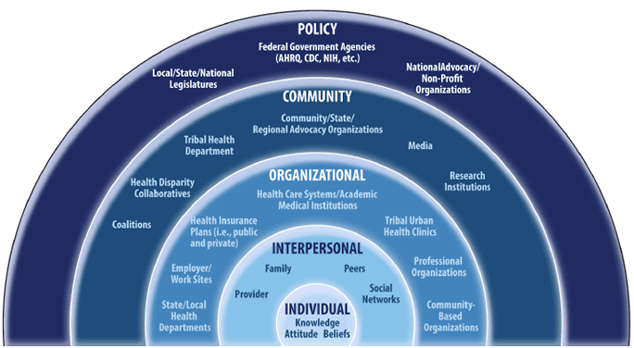
Social-Ecological Model
Notes:
When we think about services for any individual, but specific to this discussion the autism population, we have to consider all determinants of health and how they impact an individual. The Social-ecological model is often used both in social work and public health to illustrate the role each family, provider, agency, community, or government can play a role in an individuals health care.

Slide 8
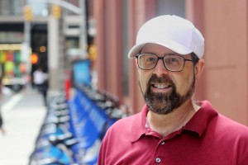
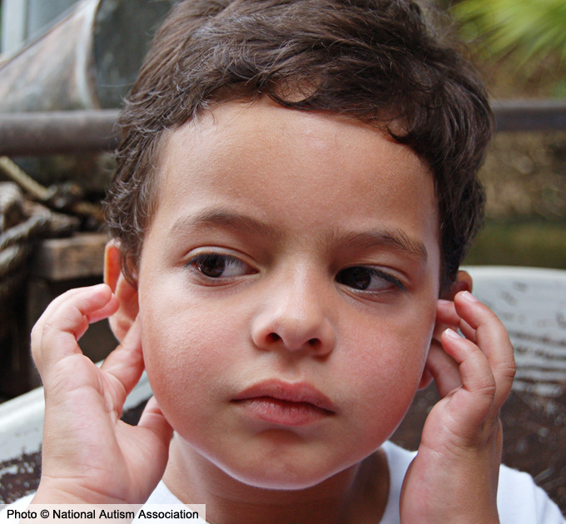

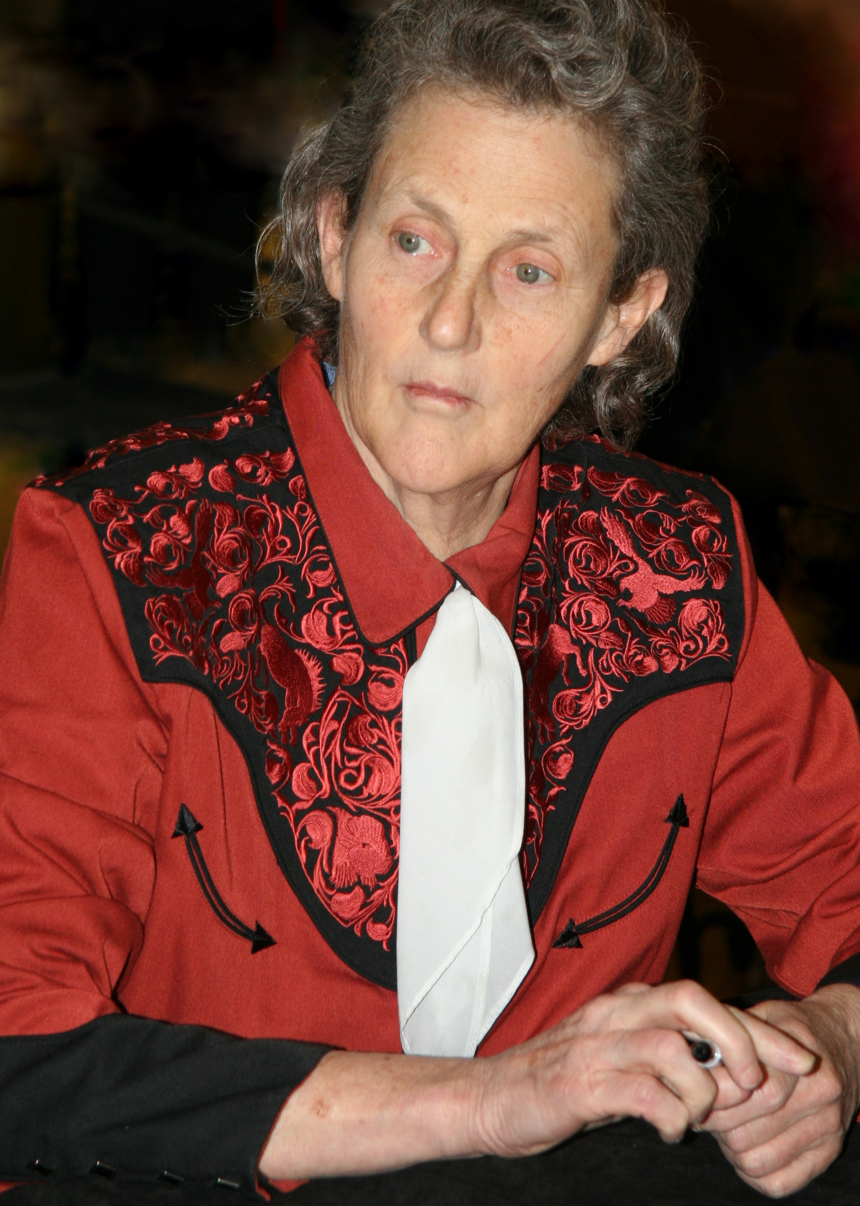

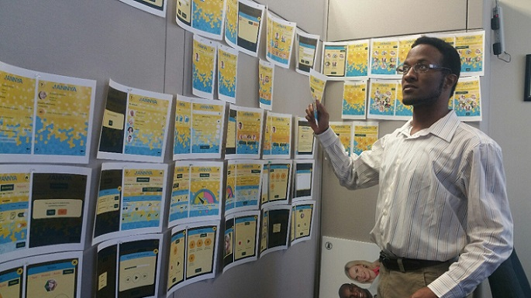
Life Course Perspective
Notes:
Lifespan (long term outcomes in mind) – comprehensive approach to care (how services are protective factors for longterm outcomes)
EI (0-2)
CRS (0-21)
VR (14+)
SAIL

Slide 9

Early Childhood & Transition to School
Parent support and education
Screening & Developmental Monitoring
Early
Intervention
Communicate with Families and Caregivers
Pre-school and kindergarten readiness
Socialization

Slide 10

School Age
Home based services and family support
School Services
Transition Planning
Private or Outpatient Services
Peer Interaction
Health and Medical Needs

Slide 11

Transitioning to adulthood
Planning for the Future:
Post-secondary Education
Job Training
Financial and Legal Services
Housing
Health Care
Socialization
Community Engagement

Slide 12
Considerations for Transition: Areas in Which Individuals May Need Support
Personal care
Cleaning and laundry
Grocery shopping
Nutrition and cooking skills
Transportation
Housing/living arrangements
Money management/ Budgeting
Medication management
Socialization
Relationships / Social cues
Community Membership
Hobbies and recreation
Addressing health needs
Advocacy
Oversight/coordination/long term planning
Guardianship
“Accessibility in Alabama” – by Brooke Bowles (Triumph Services) and Joe Carter (Glenwood Autism & Behavioral Health Center)

Slide 13

Adulthood
Education / Job Training and Support
Housing and Related Services
Socialization and community engagement
Health and Medical Needs
Community support and advocacy
Long-term
Financial & Legal
Support and Planning

Slide 14
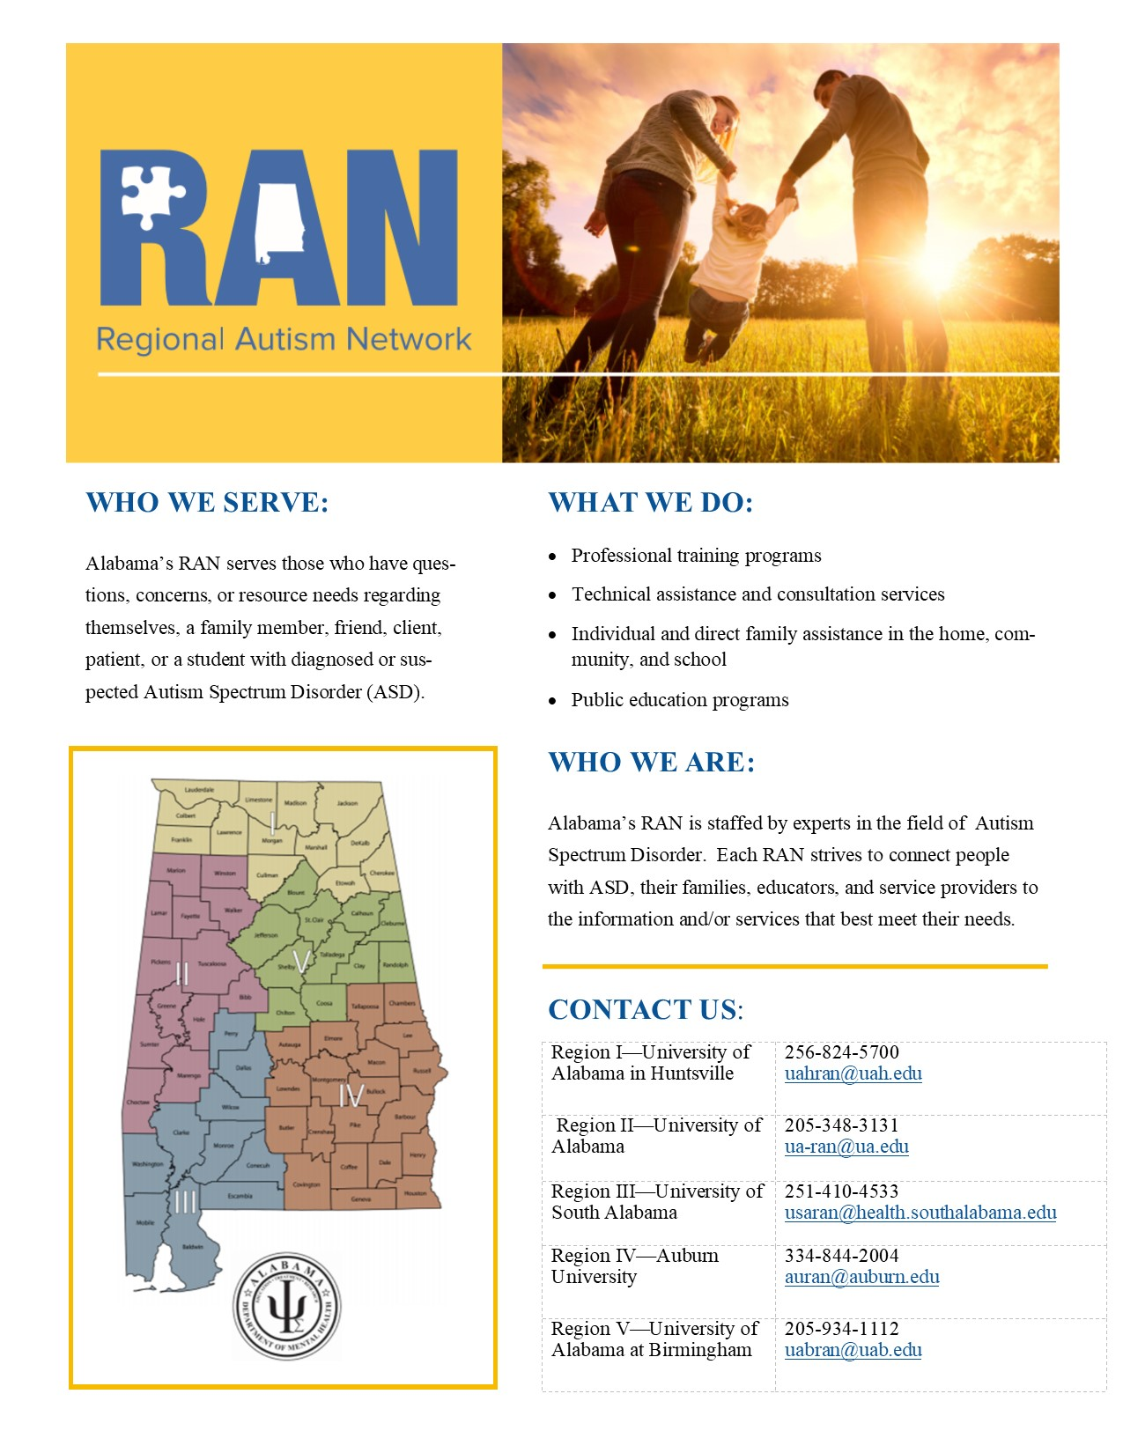
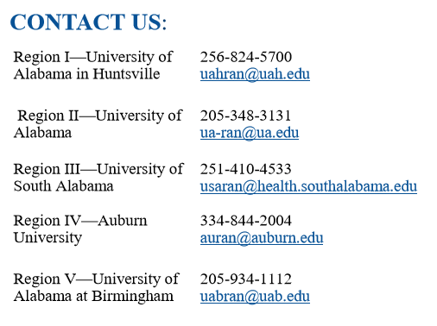
Regional Autism Network (RAN)

Slide 15
Regional Autism Networks
(d) Each center shall provide the following:
  (1) A staff that has expertise in autism and related disabilities.
  (2) Individual and direct family assistance in the home, community, and school. A center's assistance may not supplant other responsibilities of state and local agencies, and each school district shall be responsible for providing an appropriate education program for clients of a center who are school age, inclusive of preschool special education.
  (3) Technical assistance and consultation services, including specific intervention and assistance for a client of the center, the family of the client, and the school district, and any other services that are appropriate.
  (4) Professional training programs that include developing, providing, and evaluating preservice and inservice training in state-of-the-art practices for personnel who work with the populations served by the centers and their families.
  (5) Public education programs to increase awareness of the public about autism and autistic-related disabilities.
(Act 2009-592)

Slide 16
RAN Activities
Family Assistance and referral
Technical Assistance and Consultation
  Healthcare settings and medical procedures
  Project ECHO
Professional Training:
  DHR, Mental Health, AIDB,

Slide 17
RAN Activities
Public Education
  Expansion of Community Education Workshops
    Families
    Service providers
    Educators
  Project ECHO
    ECHO for Educators in the future

Slide 18
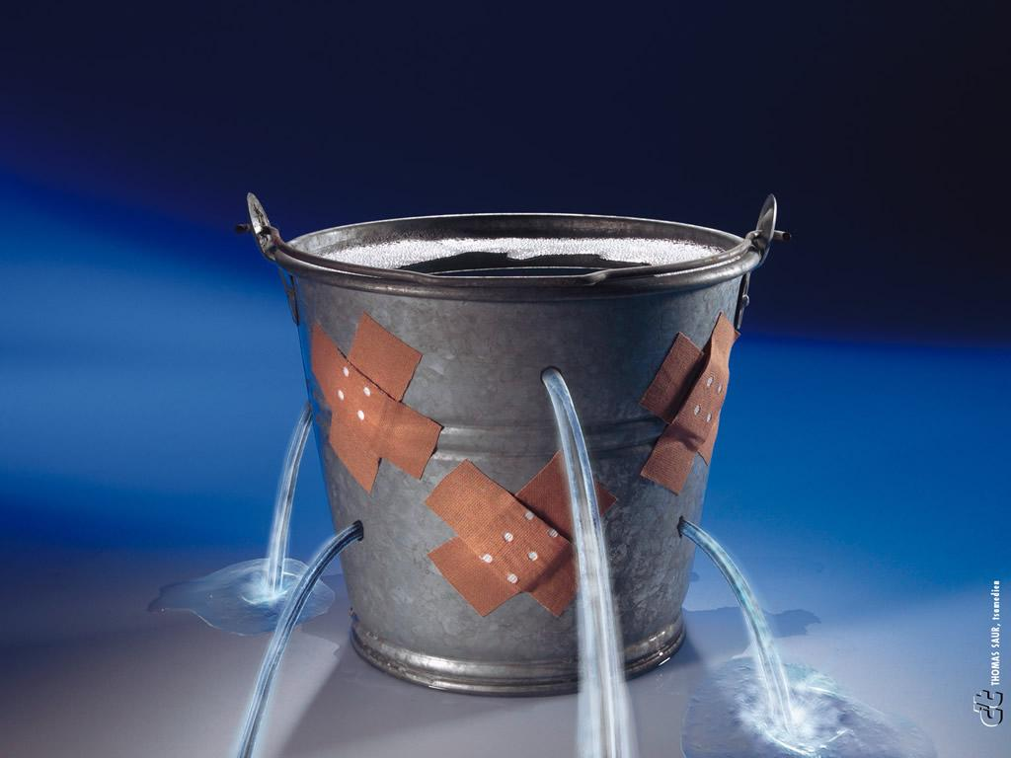
Accessing Publicly Funded Services in Alabama
Alabama Department of Education
Alabama Department of Rehabilitation Services
Alabama Department of Mental Health
Your Personal Funds
“Accessibility in Alabama” – by Brooke Bowles (Triumph Services) and Joe Carter (Glenwood Autism & Behavioral Health Center)

Slide 19
Your Funds
Alabama Family Trust
We are a non-profit, 501 (c) (3) special needs trust serving children and adults with disabilities. Our organization was created in 1994 by an act of the Alabama Legislature to encourage, enhance and foster the provisions of medical, social or other supplemental services for persons with a mental or physical impairment. alabamafamilytrust.com
Special Needs Trust
A special needs trust is a trust designed for beneficiaries who have a disability. It is written so the beneficiary can enjoy the use of property that is held in the trust for his or her benefit, while at the same time allowing the beneficiary to receive essential needs-based government benefits. Special needs trusts are sometimes known as supplemental needs trusts in the United States.
“Accessibility in Alabama” – by Brooke Bowles (Triumph Services) and Joe Carter (Glenwood Autism & Behavioral Health Center)

Slide 20

Autism Council’s Charge
The Alabama Interagency Autism Coordinating Council was created to meet the urgent and substantial need to develop and implement a statewide comprehensive, coordinated, multidisciplinary, interagency system of care for individuals with ASD and their families.
Notes:
Because there were so many issues, the Autism Task Force was created in 2007. In 2008, the Autism Needs Assessment was completed. In 2009, the AIACC was approved as the permanent entity to carry on the work of the Autism Task Force.

Slide 21
Autism Council’s Mission Statement
The Alabama Interagency Autism Coordinating Council guides a collaborative effort to facilitate a lifelong system of care and support for persons with Autism Spectrum Disorder or associated conditions and their families, so that they may enjoy a meaningful and successful life.

Slide 22
Gaps in Care and Emerging Services
  Adult services
  Comprehensive care
  Inclusion of medical providers
  Insurance barriers
  Medical providers familiar with ASD that accept Medicaid or Medicare
  Service providers that accept Medicaid and Medicare who are familiar with ASD
  Accessibility
  Health disparities among racial and SES groups
  Waitlists
  Waiver limited with extensive waitlist and IQ requirements (69 or below)
  Earlier transition services (age 14)
  More providers taking on ASD in their practices (state and private)
Notes:
HB 284
Medicaid
ASD trained providers
Licensure

Slide 23

Partner Activities around the State
First Responder Trainings
Annual Camps for families
Annual Autism Day at baseball field (Barons, Biscuits, Bay Bears)
Sensory Movies
Legislative Day
Library Program
Conferences

Slide 24

Safety Net Campaign
Ensures that all Alabama counties have a protocol for persons with ASD who may wander, bolt or elope. Project Lifesaver is a rescue and recovery program for children and adults. www.projectlifesaver.org Project Lifesaver is free to families. Contact ASA for further information about Project Lifesaver.
  Enrollees wear a small personal transmitter around the wrist or ankle
  If wandering occurs, caregivers notify Project Lifesaver and an emergency team searches
  Searches usually last minutes or hours instead of hours into days
  Wristband or ankle bracelets are difficult to self remove and are waterproof
The majority of Alabama counties participate in Project Lifesaver. Project Lifesaver can serve a family regardless of county enrollment. Families interested in Project Lifesaver for their loved one with ASD should contact ASA for further information about Project Lifesaver.
Project Lifesaver also provides a fee based at home tracking system, PAL and Freedom4Kids. This system has a $46 per month monitoring cost. http://www.projectlifesaver.org/Pal-info or 877-580-LIFE (5433).

Slide 25
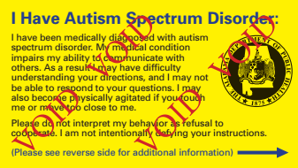
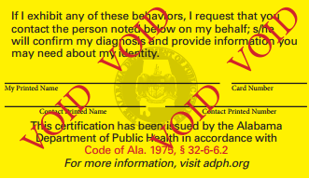
Autism ID Card
Available through AL Dept Public Health.
Complete an ASD Card Registration Form (available on ASA’s website) and bring to any county health department along with a government issued identification card or document and $10 to receive a card.
Form must be signed by healthcare provider.
Social story available on ASA webpage.

Slide 26
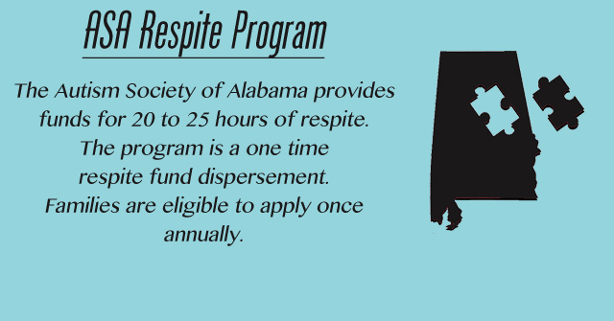

Respite Programs
Contact michelle@autism-alabama.org for more information. Application available on ASA website.
1-866-RESTALA

Slide 27
Autism Friendly Campaign
Regions, ASO, Red Mtn. Theatre Co., Birmingham, Museum of Art…
Educating local businesses and organizations about autism
Providing a mechanism for businesses/organizations to promote their awareness and autism friendly programs to families with autism
Informing local businesses/organizations about the benefits of becoming “autism friendly”

Slide 28

al.enablesavings.com
Allows individuals with disabilities to open tax-exempt savings accounts to save for disability-related expenses without impacting eligibility for resource-based benefits.
Annual contribution limit $14,000
Account limit $100,000

Slide 29
Networking Groups
Areas Represented:
Alexander City
Auburn
Birmingham
Blount County
Calhoun County
Centerpoint
Chilton County
Clarke/Washington Counties
Cullman County
Decatur/Hartselle
DeKalb County
Demopolis
Dothan
Florence
Gadsden/Etowah County
Gulf Shores
Hamilton
Huntsville
Limestone County
Lineville
Mobile
Montgomery/Tri-County
Selma/Dallas County
St. Clair County
Sumter County
Troy
Tuscaloosa
Walker County
Winfield

Slide 30
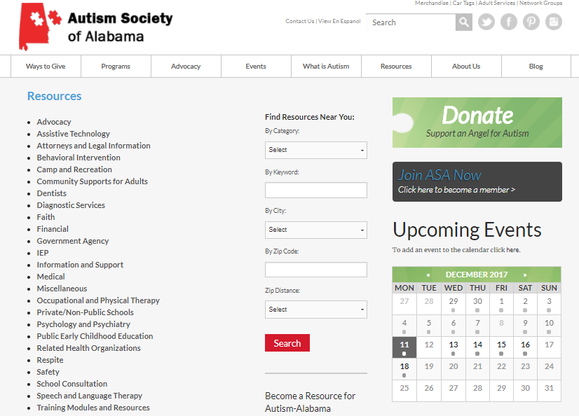
Resource Directory

Slide 31
What can you do to help?
Refer!
  To RAN, AIACC, and other advocacy and service providers previously discussed
Remember!
  OK To Approach a Family Having a Hard Time
  Safe quiet space in office for Melt Downs
  Speak in clear unrushed manner
  Convey that you are available to help families that have challenges
  Fidget toys are nice if available

Slide 32
Your ASD students/families have a Large Community. They Are Not Alone!
1 in 59 are affected.

Slide 33
Contact Regional Autism Network

Slide 34
Contact Autism Council
Anna.McConnell@mh.alabama.gov
www.autism.alabama.gov
205-478-3402

Slide 35
Questions?

